Slide 1
CSE514 – Datamining Fall 2022 The Kernel Trick for SVMs
Cynthia Ma
Department of Computer Science
Washington University in St. Louis
czma@wustl.edu

Slide 2
Quick admin follow-up
Schedule until Exam 1
Mon. Oct. 3 Kernels (Today)
Wed. Oct. 5 Programming Assignment 1 review
class will be hybrid
Mon. Oct. 10 Fall break (no class)
Wed. Oct 12 Exam 1 review (PA1 due)
class will be hybrid
Mon. Oct 17 Group extra credit exercise
Wed. Oct 19 Exam 1

Slide 3
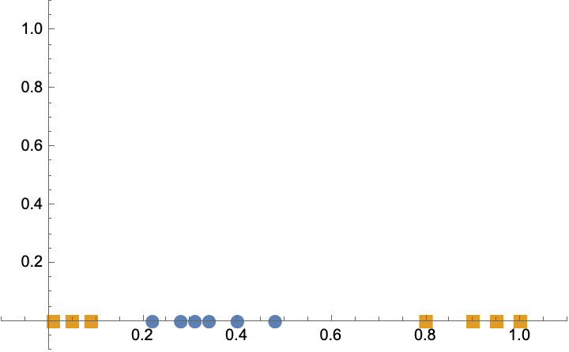
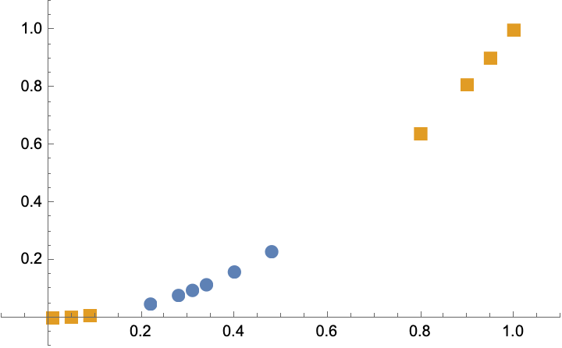
Classification Example 2
Notes:
병찬.
이게 이전 ppt 에서 일차원으로 나와서 분류가 어려웠던건데
이걸 classifier 를 하나 더 둬서 이렇게 바꾸게 되면 나눌수가 있다는거다.
여기서는 square 를 해서 값을 저렇게 구한거임.
By adding a new dimension…

Slide 4
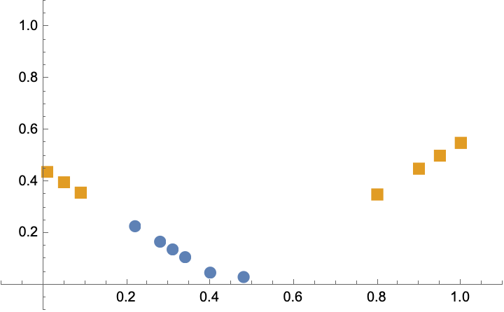
Classification Example 2
Notes:
병찬
이거는 다른 기준으로 classifier 를 다른걸 썼음.

Slide 5
How to pick feature transformation?
Option 1:
Transform the features
e.g., a polynomial or logarithmic transformation
Train a soft margin classifier
Repeat with random different transformations until performance stops improving (cross validation)
Option 2:
Use the kernel trick with dual problem optimization to systematically search for the best transformation (cross validation)
Notes:
병찬
그러면 이걸 어떻게 알고 추가를 하느냐???
다항식을 쓰던지 로그함수를 쓰던지 하자는거다.
옵션2를 배우는거임.

Slide 6
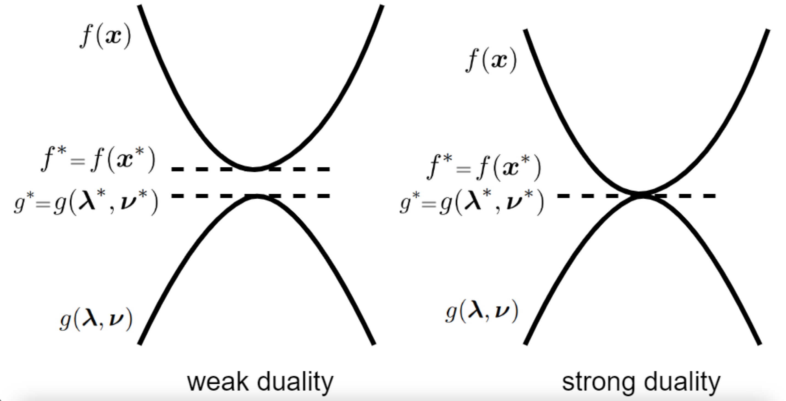
Dual problem optimization
The Duality Principle of mathematical optimization:
Any feasible solution to a primal (minimization) problem is at least as large (an upper bound) as any feasible solution to the dual (maximization) problem

Slide 7
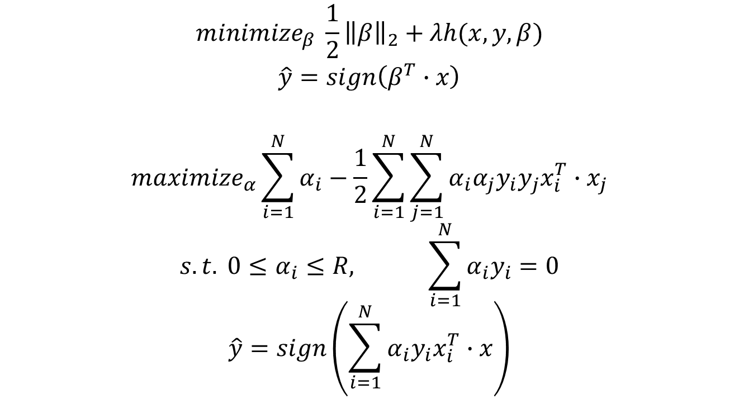
Primal vs. Dual of SVM
$${minimize}_{β} \frac{1}{2}{\left\|β\right\|}_{2}+λh(x,y,β)$$
$$\hat{y}=sign\left(β^{T}∙x\right)$$
$${maximize}_{α}\sum_{i=1}^{N}{α_{i}}−\frac{1}{2}\sum_{i=1}^{N}{\sum_{j=1}^{N}{α_{i}α_{j}y_{i}y_{j}x_{i}^{T}∙x_{j}}}$$
$$s.t. 0≤α_{i}≤R, \sum_{i=1}^{N}{α_{i}y_{i}=0}$$
$$\hat{y}=sign\left(\sum_{i=1}^{N}{α_{i}y_{i}x_{i}^{T}}∙x\right)$$
Notes:
병찬
녹색 동그라미만 중요하다. 이걸 다 이해는 안해도 된다.

Slide 8
Polynomial kernel
$${maximize}_{α}\sum_{i=1}^{N}{α_{i}}−\frac{1}{2}\sum_{i=1}^{N}{\sum_{j=1}^{N}{α_{i}α_{j}y_{i}y_{j}x_{i}∙x_{j}}}$$
For the example classification, $x_{i}∙x_{j}$ in two dimensions:
$\left[x_{i} \right]∙\left[x_{j} \right] →\left[x_{i},{x_{i}}^{2}\right]∙\left[x_{j},{x_{j}}^{2}\right]=x_{i}x_{j}+{x_{i}}^{2}{x_{j}}^{2}$
Or use the polynomial kernel:
$${\left(a∙b+r\right)}^{d} : {\left(x_{i}x_{j}+\frac{1}{2}\right)}^{2}=x_{i}x_{j}+{x_{i}}^{2}{x_{j}}^{2}+\frac{1}{4}$$

Slide 9
Polynomial kernel examples
$${\left(a∙b+r\right)}^{d} : {\left(x_{i}x_{j}+\frac{1}{2}\right)}^{2}=x_{i}x_{j}+{x_{i}}^{2}{x_{j}}^{2}+\frac{1}{4}$$
What if we change d = 3?
$${\left(x_{i}x_{j}+\frac{1}{2}\right)}^{3}={x_{i}}^{3}{x_{j}}^{3}+\frac{3}{2}{x_{i}}^{2}{x_{j}}^{2}+\frac{3}{4}x_{i}x_{j}+\frac{1}{8}$$
What if we change r = 1?
$${\left(x_{i}x_{j}+1\right)}^{3}={x_{i}}^{3}{x_{j}}^{3}+3{x_{i}}^{2}{x_{j}}^{2}+3x_{i}x_{j}+1$$

Slide 10
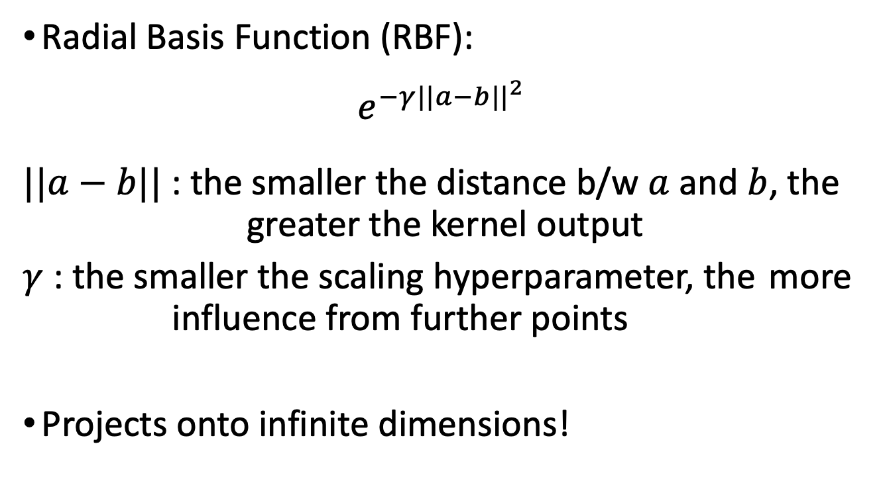
Radial Basis Function kernel
Radial Basis Function (RBF):
$$e^{−γ{||a−b||}^{2}}$$
$||a−b||$ : the smaller the distance b/w $a$ and $b$, the greater the kernel output
$γ$ : the smaller the scaling hyperparameter, the more influence from further points
Projects onto infinite dimensions!

Slide 11
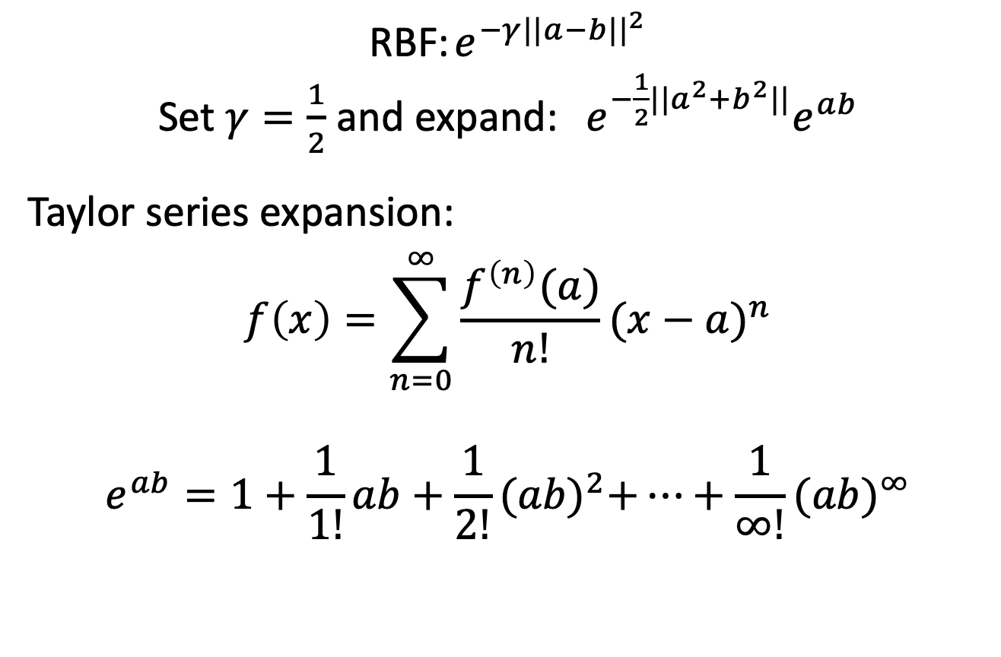
Infinite dimensions?
RBF: $e^{−γ{||a−b||}^{2}}$
Set $γ=\frac{1}{2}$ and expand: ${e^{−\frac{1}{2}{||a^{2}+b}^{2}||}e}^{ab}$
Taylor series expansion:
$$f\left(x\right)=\sum_{n=0}^{∞}{\frac{f^{\left(n\right)}(a)}{n!}{(x−a)}^{n}}$$
$$e^{ab}=1+\frac{1}{1!}ab+\frac{1}{2!}{(ab)}^{2}+…+\frac{1}{∞!}{(ab)}^{∞}$$

Slide 12
Homework
HW4 is due tomorrow at midnight
HW3 regrade requests are due tomorrow at midnight
Programming Assignment 1 is due October 12
Next class is hybrid for handling PA1 questions

